Slide 1
Fast Food Product’s Nutrition Value
How different nutritional value elements interact
Ionescu Ariana-Georgiana 511

Slide 2
The problem
Dataset
Analysis
Predictions
The dataset contains products from 6 major fast food chains and nutritional values for each.
What insights can we obtain about each restaurant chain and its products?
Would it be possible, with the clean data, to make predictions about which fast food chain products are from?

Slide 3
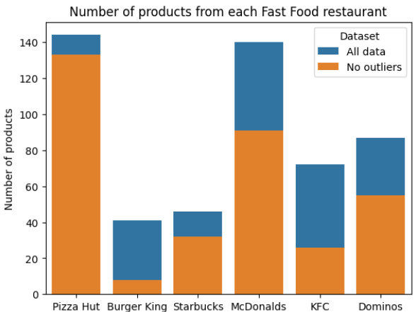
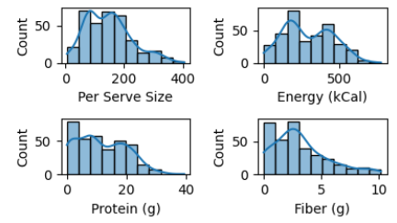
Taking a closer look at the initial dataset
Company | Category | Product | Per Serve Size | Numerical columns
The name of one out of the 6 companies | The product category | The product name | The size of one serving | Nutrition Value features such as: protein, fiber, total fat.

Slide 4
Data preprocessing
Changing column types
Replacing null values
Removing outliers
The Per Serve Size column has grams and milliliters, we convert it to just numerical data.
Multiple columns have null values that we replace with the value 0, to not remove rows.
During a simple distribution visualization we can see that there are many outliers for each column. We need a database without them for classifying.

Slide 5
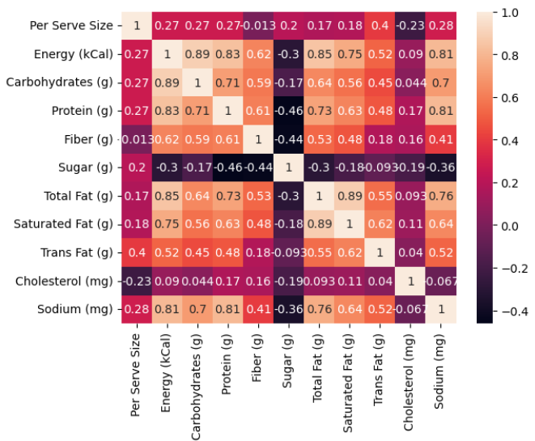
Correlation between different features
After cleaning the data and removing the outliers it would be be interesting to look at the correlation between the features to see in greater detail how they interact with each other.

Slide 6
Nutri-Score
The Nutri-Score is a color-coded label (A to E) that rates the nutritional quality of food, with A (green) being the healthiest and E (red) the least healthy.
It takes into account different nutrition value content: protein, fiber, saturated fats, sugar, salt, calorie density and if the product is solid or a beverage.
We introduce a new dimension to help us analyze the data further

Slide 7
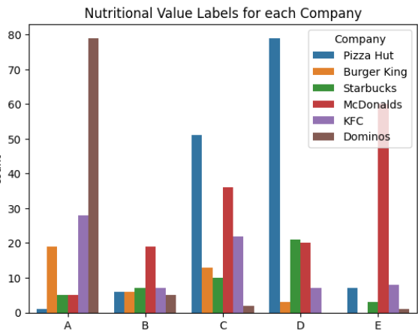
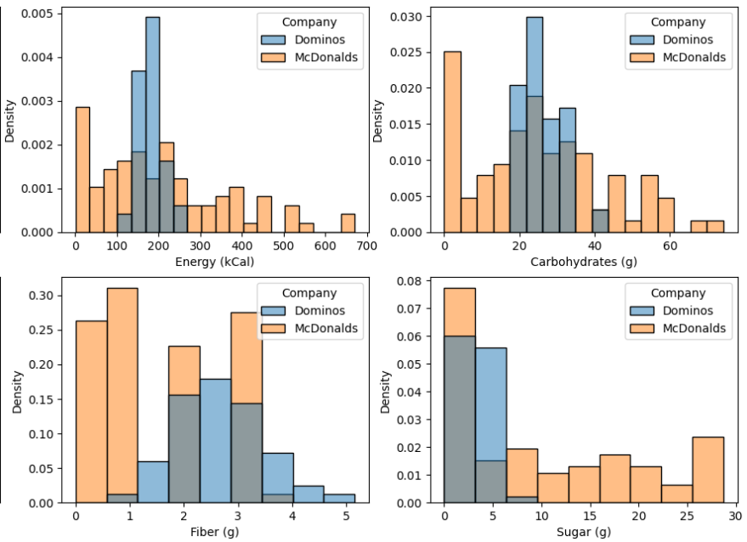
Distribution of Nutri-Scores

Slide 8
Making company predictions based on the nutrition value features
Do these 6 fast food restaurants have different enough nutrition values so that it would be possible to predict which company a product is from based on the features?
Using a Random Forest Classification algorithm, only on the numerical data, we are able to predict the company with 96% accuracy.

Slide 9
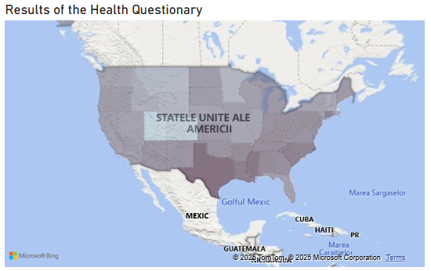
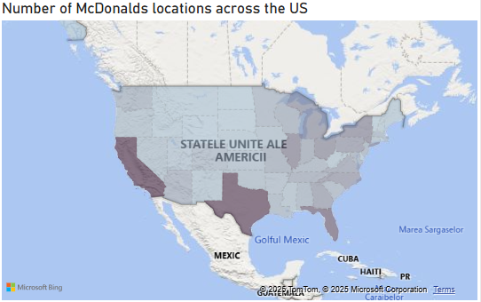
Further Analysis
From the plot about Nutri-Score we were able to deduce that McDonald’s does not have the healthiest options available. Using data about eating habits and obesity percentage across the US and the number of McDonald’s locations in each state could give us further insight into obesity causes.
We can see some relevance, but not very high.

Slide 10
Thank you!
Dataset sources:
Nutritional values:
https://www.kaggle.com/datasets/rakkesharv/fast-food-joint-nutrition-values-dataset
Health Survey:
https://data.cdc.gov/Nutrition-Physical-Activity-and-Obesity/Nutrition-Physical-Activity-and-Obesity-Behavioral/hn4x-zwk7/about_data
McDonald’s across the US:
https://www.kaggle.com/datasets/mdmdata/mcdonalds-locations-united-states

